Slide 1
Database Architecture
Centralized databases
One to a few cores, shared memory
Client-server,
One server machine executes work on behalf of multiple client machines.
Parallel databases
Many core shared memory
Shared disk
Shared nothing
Distributed databases
Geographical distribution
Schema/data heterogeneity
Notes:
1

Slide 2
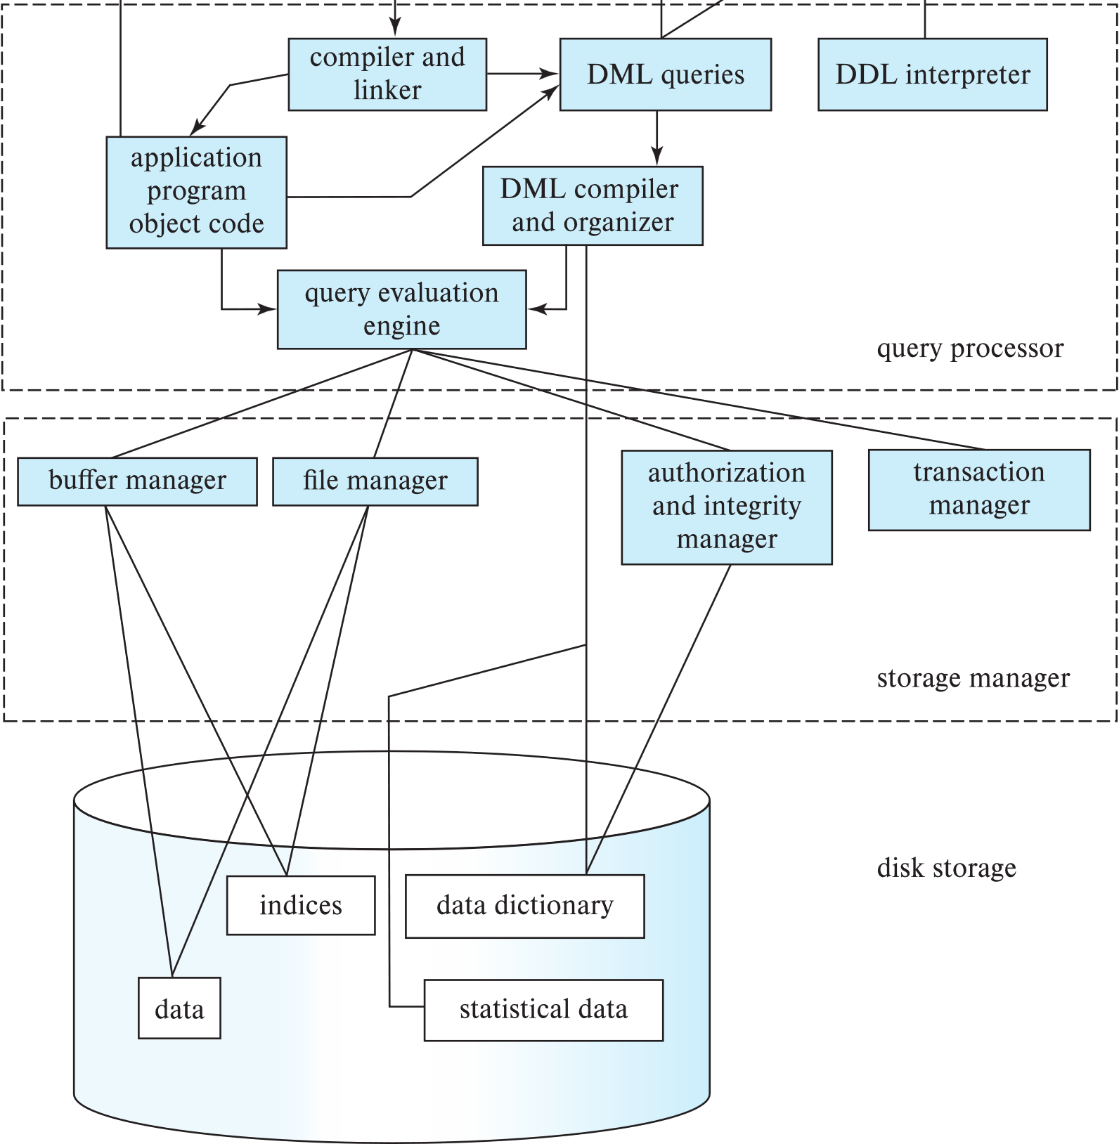
Database Architecture (Centralized/Shared-Memory)

Slide 3
Database Applications
Database applications are usually partitioned into two or three parts
Two-tier architecture -- the application resides at the client machine, where it invokes database system functionality at the server machine
Three-tier architecture -- the client machine acts as a front end and does not contain any direct database calls.
The client end communicates with an application server, usually through a forms interface.
The application server in turn communicates with a database system to access data.
Notes:
3

Slide 4
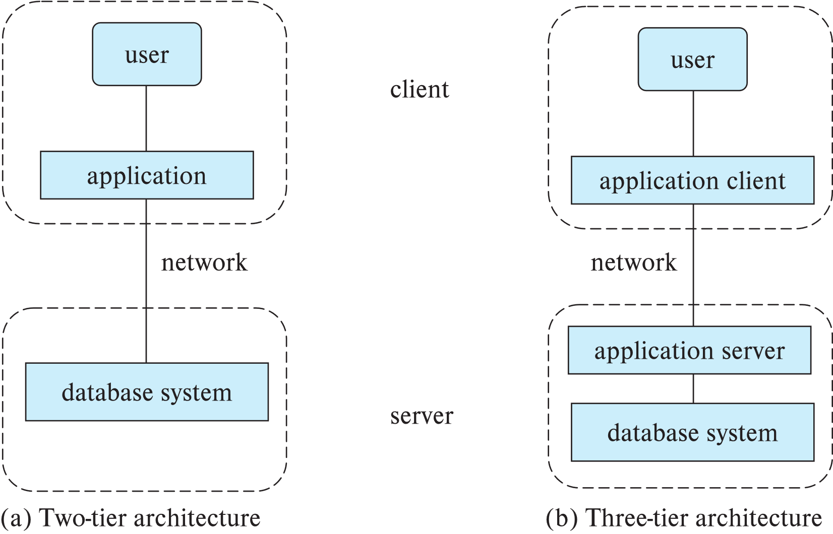
Two-tier and three-tier architectures
Notes:
4

Slide 5
History of Database Systems
1950s and early 1960s:
Data processing using magnetic tapes for storage
Tapes provided only sequential access
Punched cards for input
Late 1960s and 1970s:
Hard disks allowed direct access to data
Network and hierarchical data models in widespread use
Ted Codd defines the relational data model
Would win the ACM Turing Award for this work
IBM Research begins System R prototype
UC Berkeley (Michael Stonebraker) begins Ingres prototype
Oracle releases first commercial relational database
High-performance (for the era) transaction processing
Notes:
5

Slide 6
History of Database Systems (Cont.)
1980s:
Research relational prototypes evolve into commercial systems
SQL becomes industrial standard
Parallel and distributed database systems
Wisconsin, IBM, Teradata
Object-oriented database systems
1990s:
Large decision support and data-mining applications
Large multi-terabyte data warehouses
Emergence of Web commerce
Notes:
6

Slide 7
History of Database Systems (Cont.)
2000s
Big data storage systems
Google BigTable, Yahoo PNuts, Amazon,
“NoSQL” systems.
Big data analysis: beyond SQL
Map reduce and friends
2010s
SQL reloaded
SQL front end to Map Reduce systems
Massively parallel database systems
Multi-core main-memory databases
Notes:
7

Slide 8
End of Chapter 1
Notes:
8

